Slide 1



Leveraging Machine Learning for Credit Card Fraud Detection
Nguyễn Thị Dung – Team Leader
Nguyễn Quốc Anh
Trần Trương Minh Thắng
Nguyễn Quốc Bảo
Lê Thảo Vy
Dương Gia Thành
Made by Avengers Team
08-2023

Slide 2

CONTENT
1
2
3
Introduction
Dataset Explanation
Technical Application
4
5
6
Dashboard
Fraud Detection Model
Limitation

Slide 3

1. Introduction
Fraud Credit Card Transactions problem.
Develop a application to regconize Fraud Transactions.
Using Machine Learning to train and test.

Slide 4

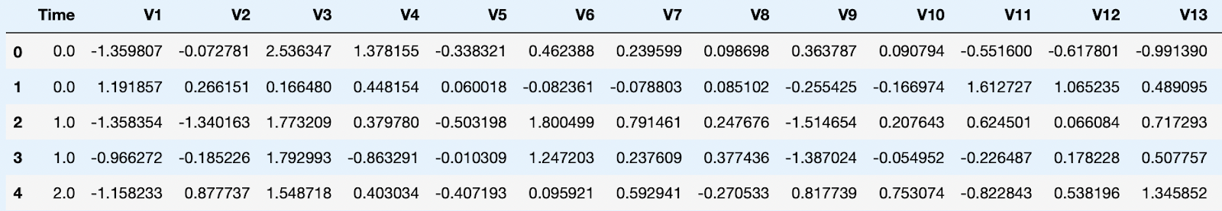
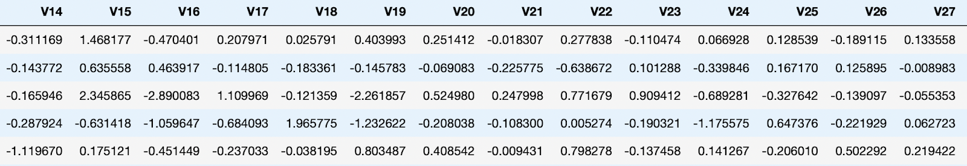
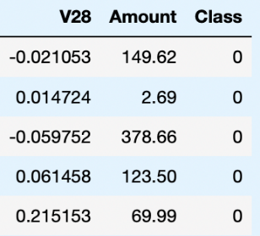
2. Dataset Explaination
- 28 anonymized numerical features obtained through Principal Component Analysis (PCA).
- The dataset's imbalance, with fraudulent transactions being a small fraction,
poses a unique challenge and necessitates special handling.
Dataset Source: https://www.kaggle.com/datasets/mlg-ulb/creditcardfraud/code

Slide 5

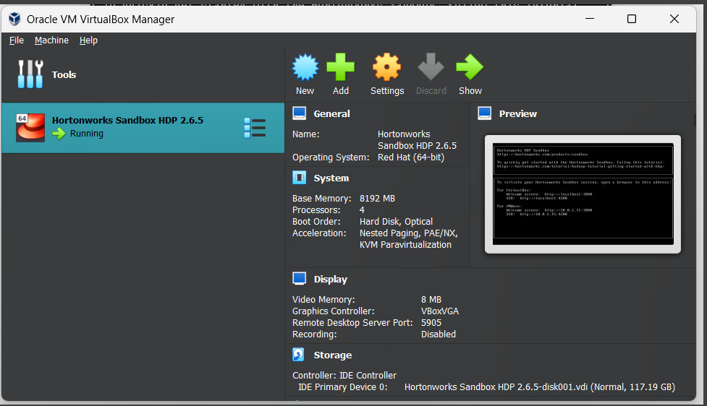
3. Technical Application
3.1 Hardware Specification
3.2 Software
Technologies to be used: Data Store: HDFS 3.x, Apache Spark 3.x 2.
Programming: Python 3.8
Visualization: Tableau Desktop 2023.2

Slide 6
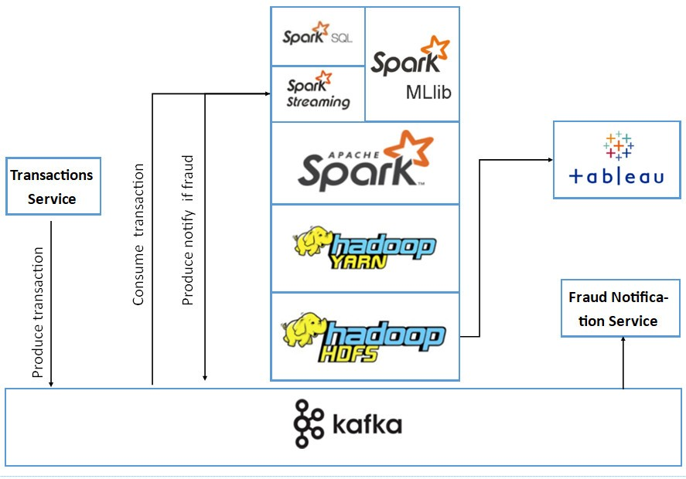
3. Technical Application

Slide 7

4. Dashboard
Created By

Slide 8
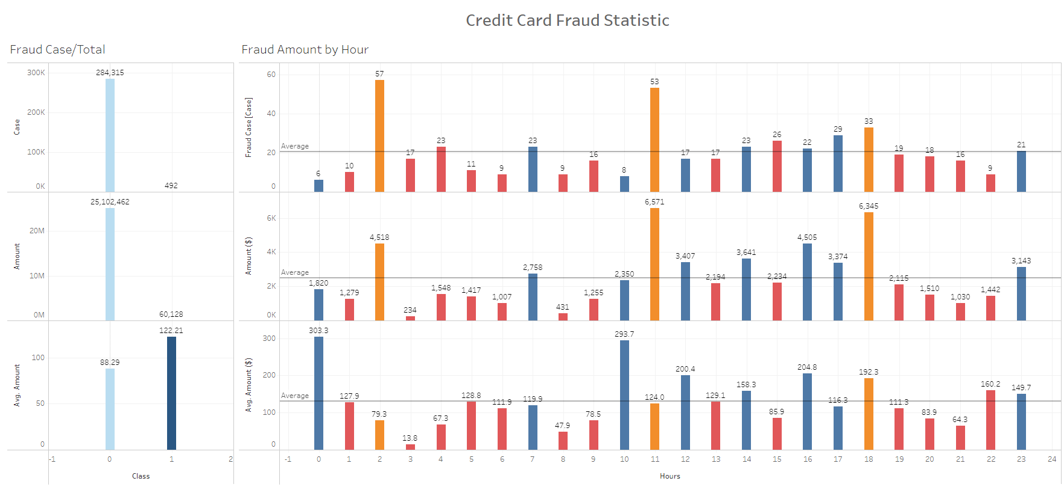
4. Dashboard

Slide 9
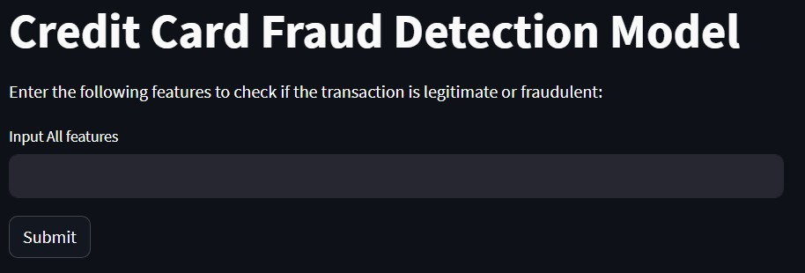
5. Fraud Detection Model

Slide 10
6. Limitation
Data Imbalance Handling
Feature Engineering Limitations
Modeling Constraints
Scalability and Real-time Deployment

Slide 11

THANKS
For Your Attention

